Slide 1


Children’s Hospital Ambulance Transfer Data Analysis
By: Elizabeth Chin
Notes:
Good afternoon everyone! I would like to thank you all for your time. I look forward to discussing my Cap Stone project today on Pittsburgh Children’s Hospital Ambulance Transfer Data Analysis.

Slide 2


Introduction
Notes:
The Children's Hospital of Pittsburgh is a leading medical institution renowned for providing exceptional care to children. As part of their commitment to providing world-class medical services to their patients, they collect and analyze data related to their ambulance transfers. The goal is to gain insights into the referrals, in order to improve the quality of care and better serve the medical needs of their young patients.
Data analysis has become an integral part of decision-making in various fields, including healthcare. With the advent of technology and the accumulation of large amounts of data, it is crucial to develop tools to analyze and interpret this data effectively. One such tool is Power BI, a business analytics service by Microsoft that provides interactive visualizations and business intelligence capabilities with an interface designed to create dashboards and reports.

Slide 3
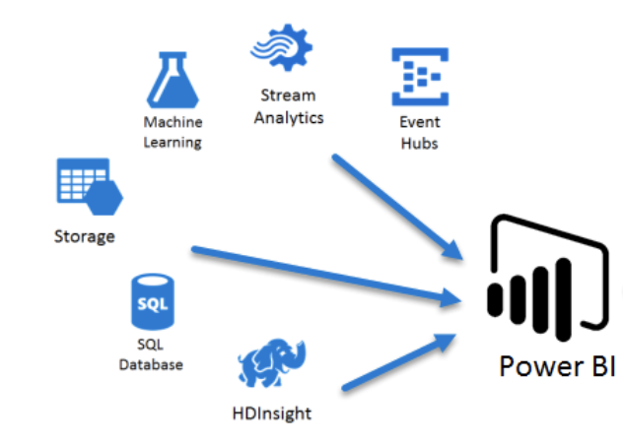
Background
Notes:
For this project, I created a Power BI dashboard to analyze the three-month referrals of Children's Hospital of Pittsburgh ambulance transfers. The dashboard is designed to provide insights into the various aspects of ambulance transfers, such as admission date, inpatient and emergency admissions, ambulance usage, and reasons for the visit. To ensure compliance with HIPAA and PHI laws, I took the necessary precautions to ensure the safe masking of all healthcare information.
The project will focus on using hospital data to identify patterns, trends, and insights related to patient outcomes and hospital operations. The data will be obtained from the Children Hospital in Pittsburgh, and it will include information on patient demographics, length of stays, ambulance zip codes, and etc. The data will be analyzed using various visualizations and tools available in Power BI.

Slide 4



Objectives
To provide insight into the 3-month referrals of the ambulance transfers for Children's Hospital of Pittsburgh
Notes:
The primary objective of this project is to provide insight into the 3-month referrals of the ambulance transfers for Children's Hospital of Pittsburgh. The project is intended to help healthcare professionals better understand the referrals and facilitate informed decision-making. Specifically, the following metrics were tracked: the number of inpatient and emergency admissions, the volume of ambulance utilization, and the patients' reasons for visiting the hospital. By analyzing the data, I aim to gain insights into the various factors that influence ambulance transfers, such as geographical location, age, and gender of the patients, complaints, and reason for the visit.

Slide 5
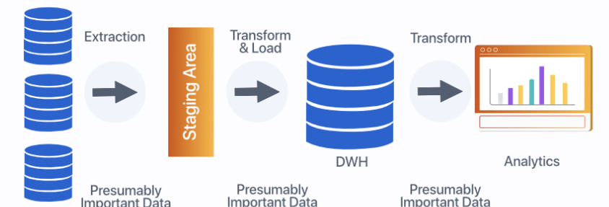
Methodology
Notes:
In order to achieve the objectives of the study, the methodology involved several sequential stages. These stages included data collection, data cleaning and transformation, and data visualization using Microsoft Power BI tool. The data collection process involved the identification and collection of data from referral sources into a single data warehouse. To ensure data accuracy and completeness, the collected data underwent a thorough cleaning process that involved removing duplicates, missing values, and outliers. The transformed data was then used to import onto Power BI. Finally, the Power BI tool was used to visualize the data into interactive and dynamic dashboards.
The data collection process for this project involved obtaining data from the electronic medical records (EMRs) of patients at Children’s Hospital Pittsburgh (CHP). The data was obtained from the CHP data warehouse, which is managed by the hospital's IT department. The dataset included patient demographic information, admission details, disposition, complaints, medical record number (MRN), etc. The data was collected over a period of three months, from January 1st, 2023, to March 31st, 2023. Data sources were primarily generated from the EMRs of inpatient and outpatient encounters that occurred during this period. The data was collected using a secure and HIPAA-compliant process, with access restricted to authorized personnel.
Prior to the commencement of data analysis, the dataset was cleaned, and any errors or inconsistencies were corrected. Data de-identification was also performed to ensure patient privacy and confidentiality. This involved masking or removing any personally identifiable information, such as patient names, text fin, numeric fin, etc. The final dataset contained a total of 2,661 patient encounters, providing a rich resource for data analysis using Power BI. The accurate and detailed data collection process enables us to conduct meaningful analysis to identify trends and patterns in patient care, which can be used to optimize clinical workflows and improve patient outcomes.
My capstone project also demonstrated the effective illustration of the data visualization and interpretation. I made use of various chart types, such as tables, pie charts, and bar charts, to present the data effectively. The presented data was efficiently interpreted and helped the hospital staff in understanding the trends and patterns of patient demographics, hospital performance, and other critical information. The layout and design of the visualizations were strategically planned to make them more readable and understandable to the intended audience. For example, I used specific color-coding shading schemes to distinguish from most to least in ambulance group, age, and complaints.
In addition, I incorporated various interactive features, such as drill-throughs and filters, that helped the end-users to dynamically change the data displayed on the dashboard. For example, I can drill down ED admissions by month, year, day of week, and arrival hour based on the filters I created. Another interactive feature I created is a geo mapping of all the zip codes that represents the location of ambulance transfers, which allowed me to better understand the distribution of referrals. In one of my classes from this semester, I learned that a person’s zip code remains a more accurate determinant of health than his or her genetic code.
This made the data visualization more user-friendly and responsive.

Slide 6
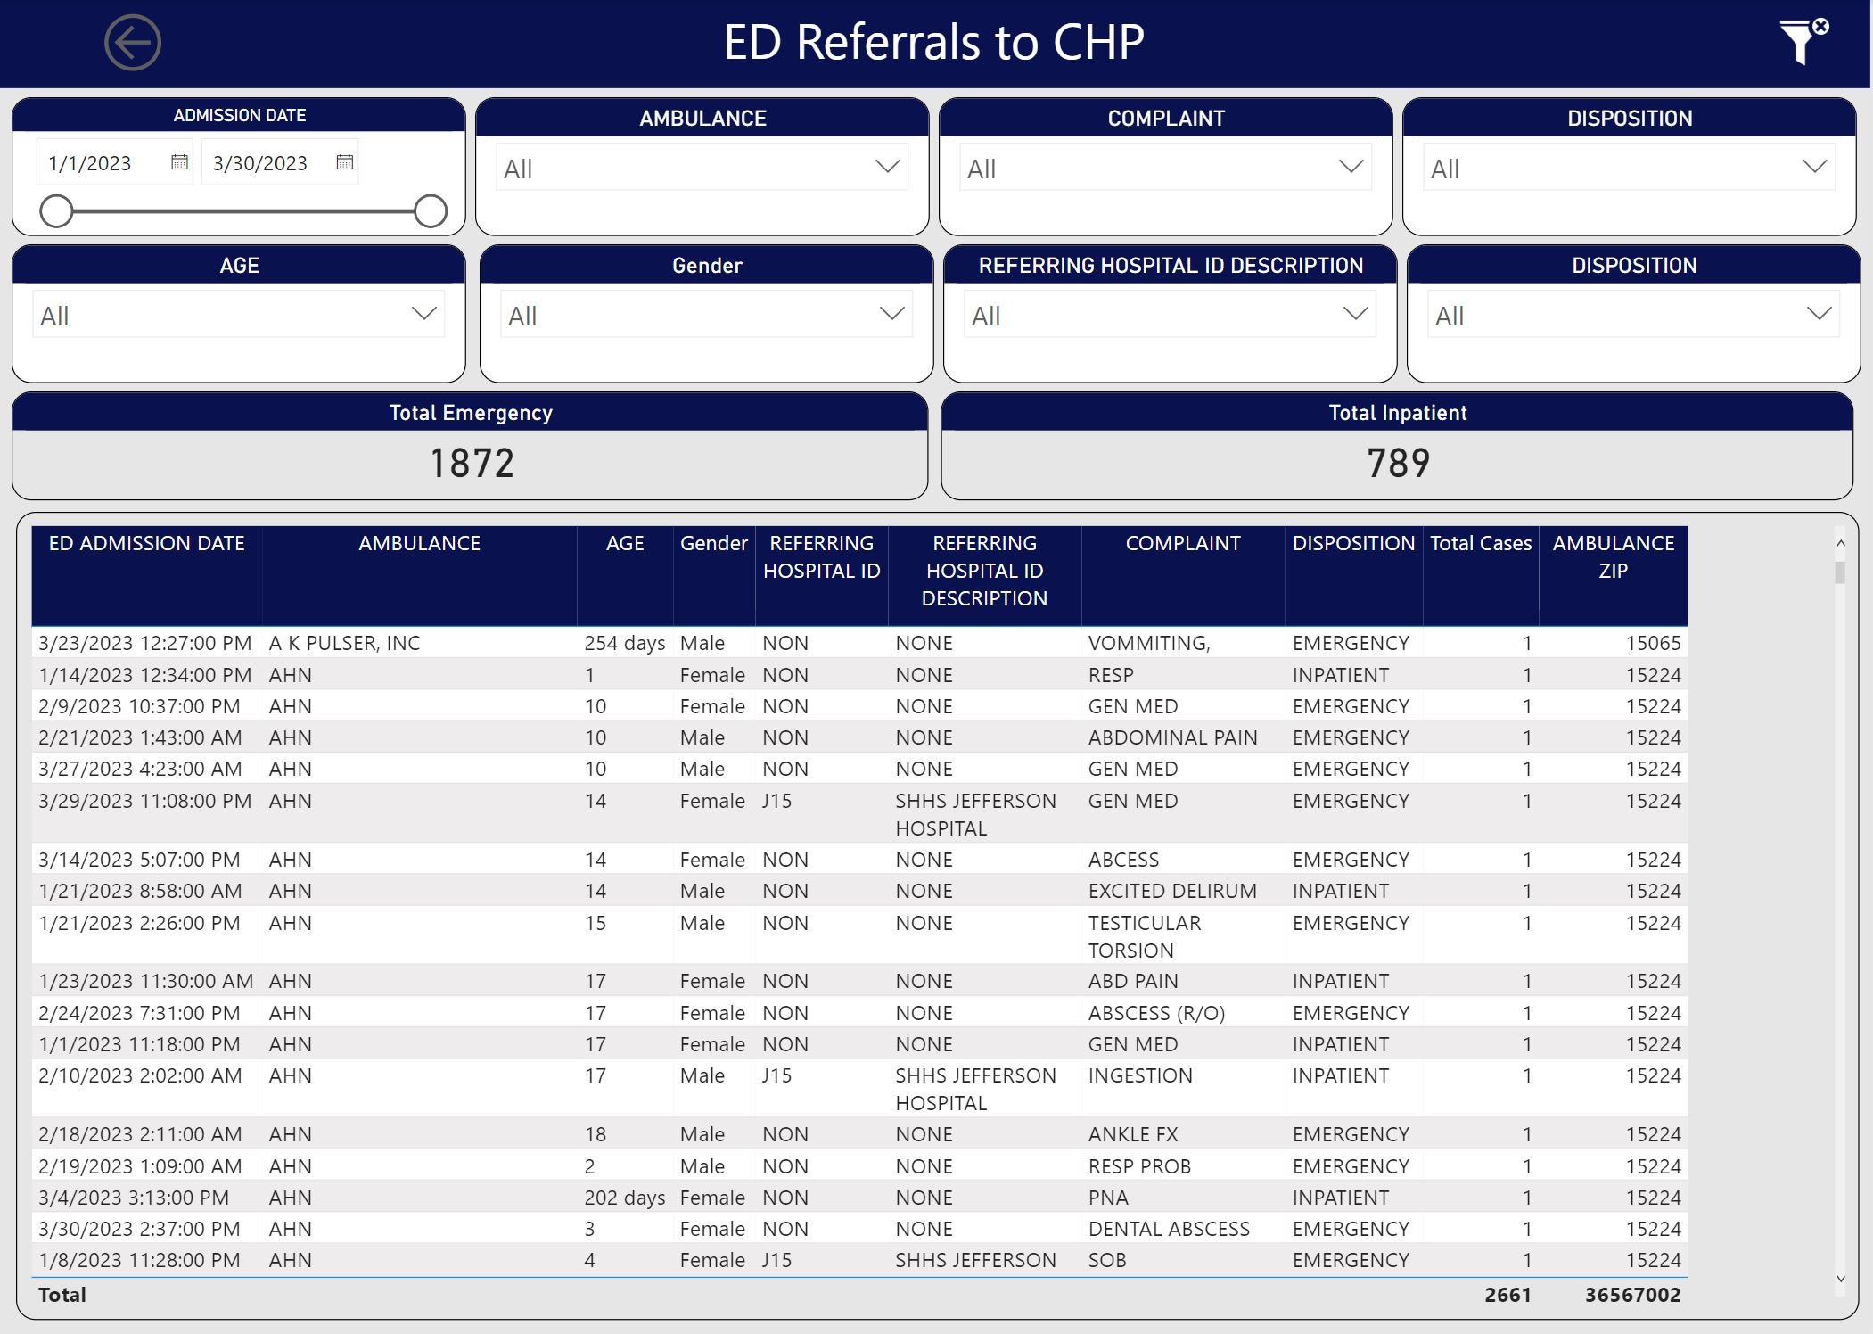
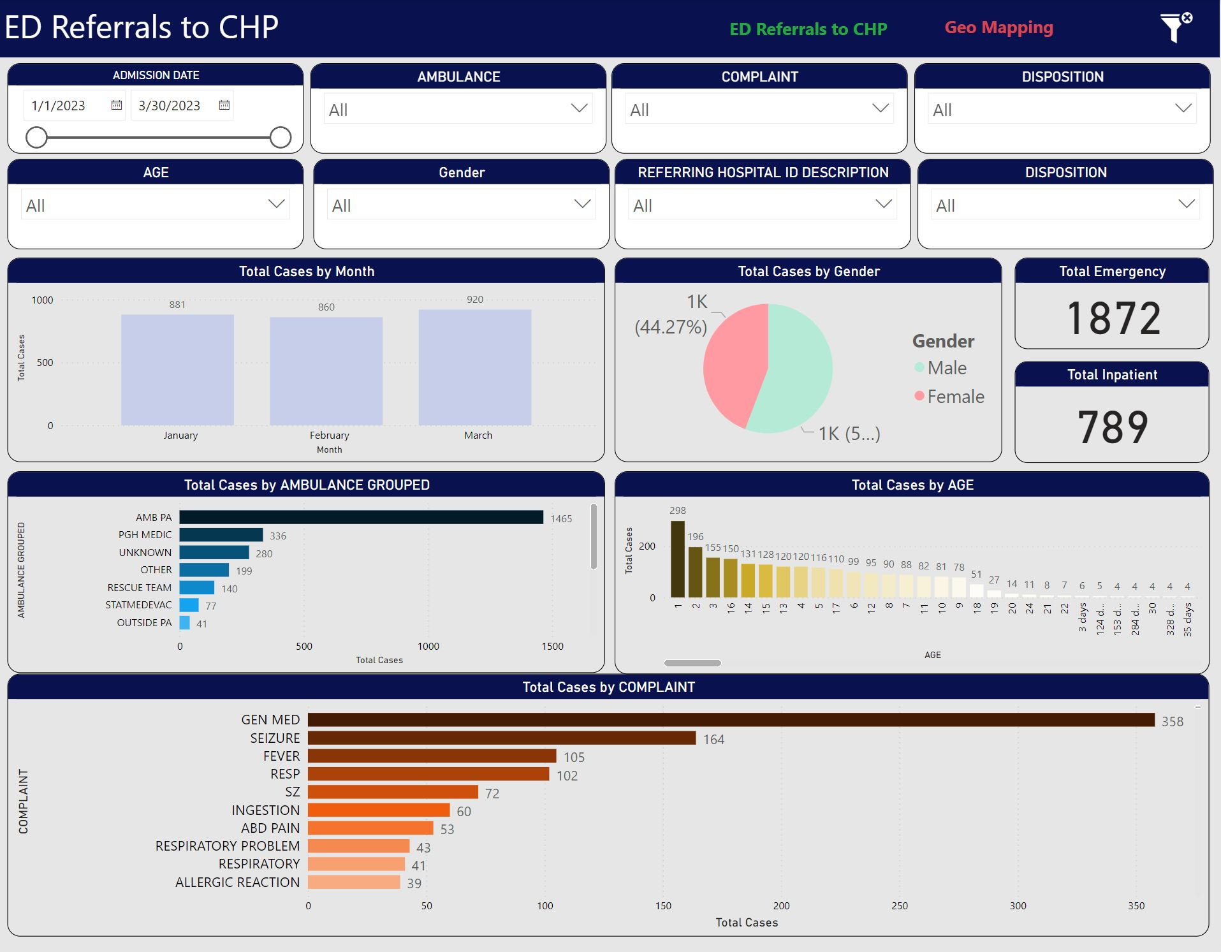
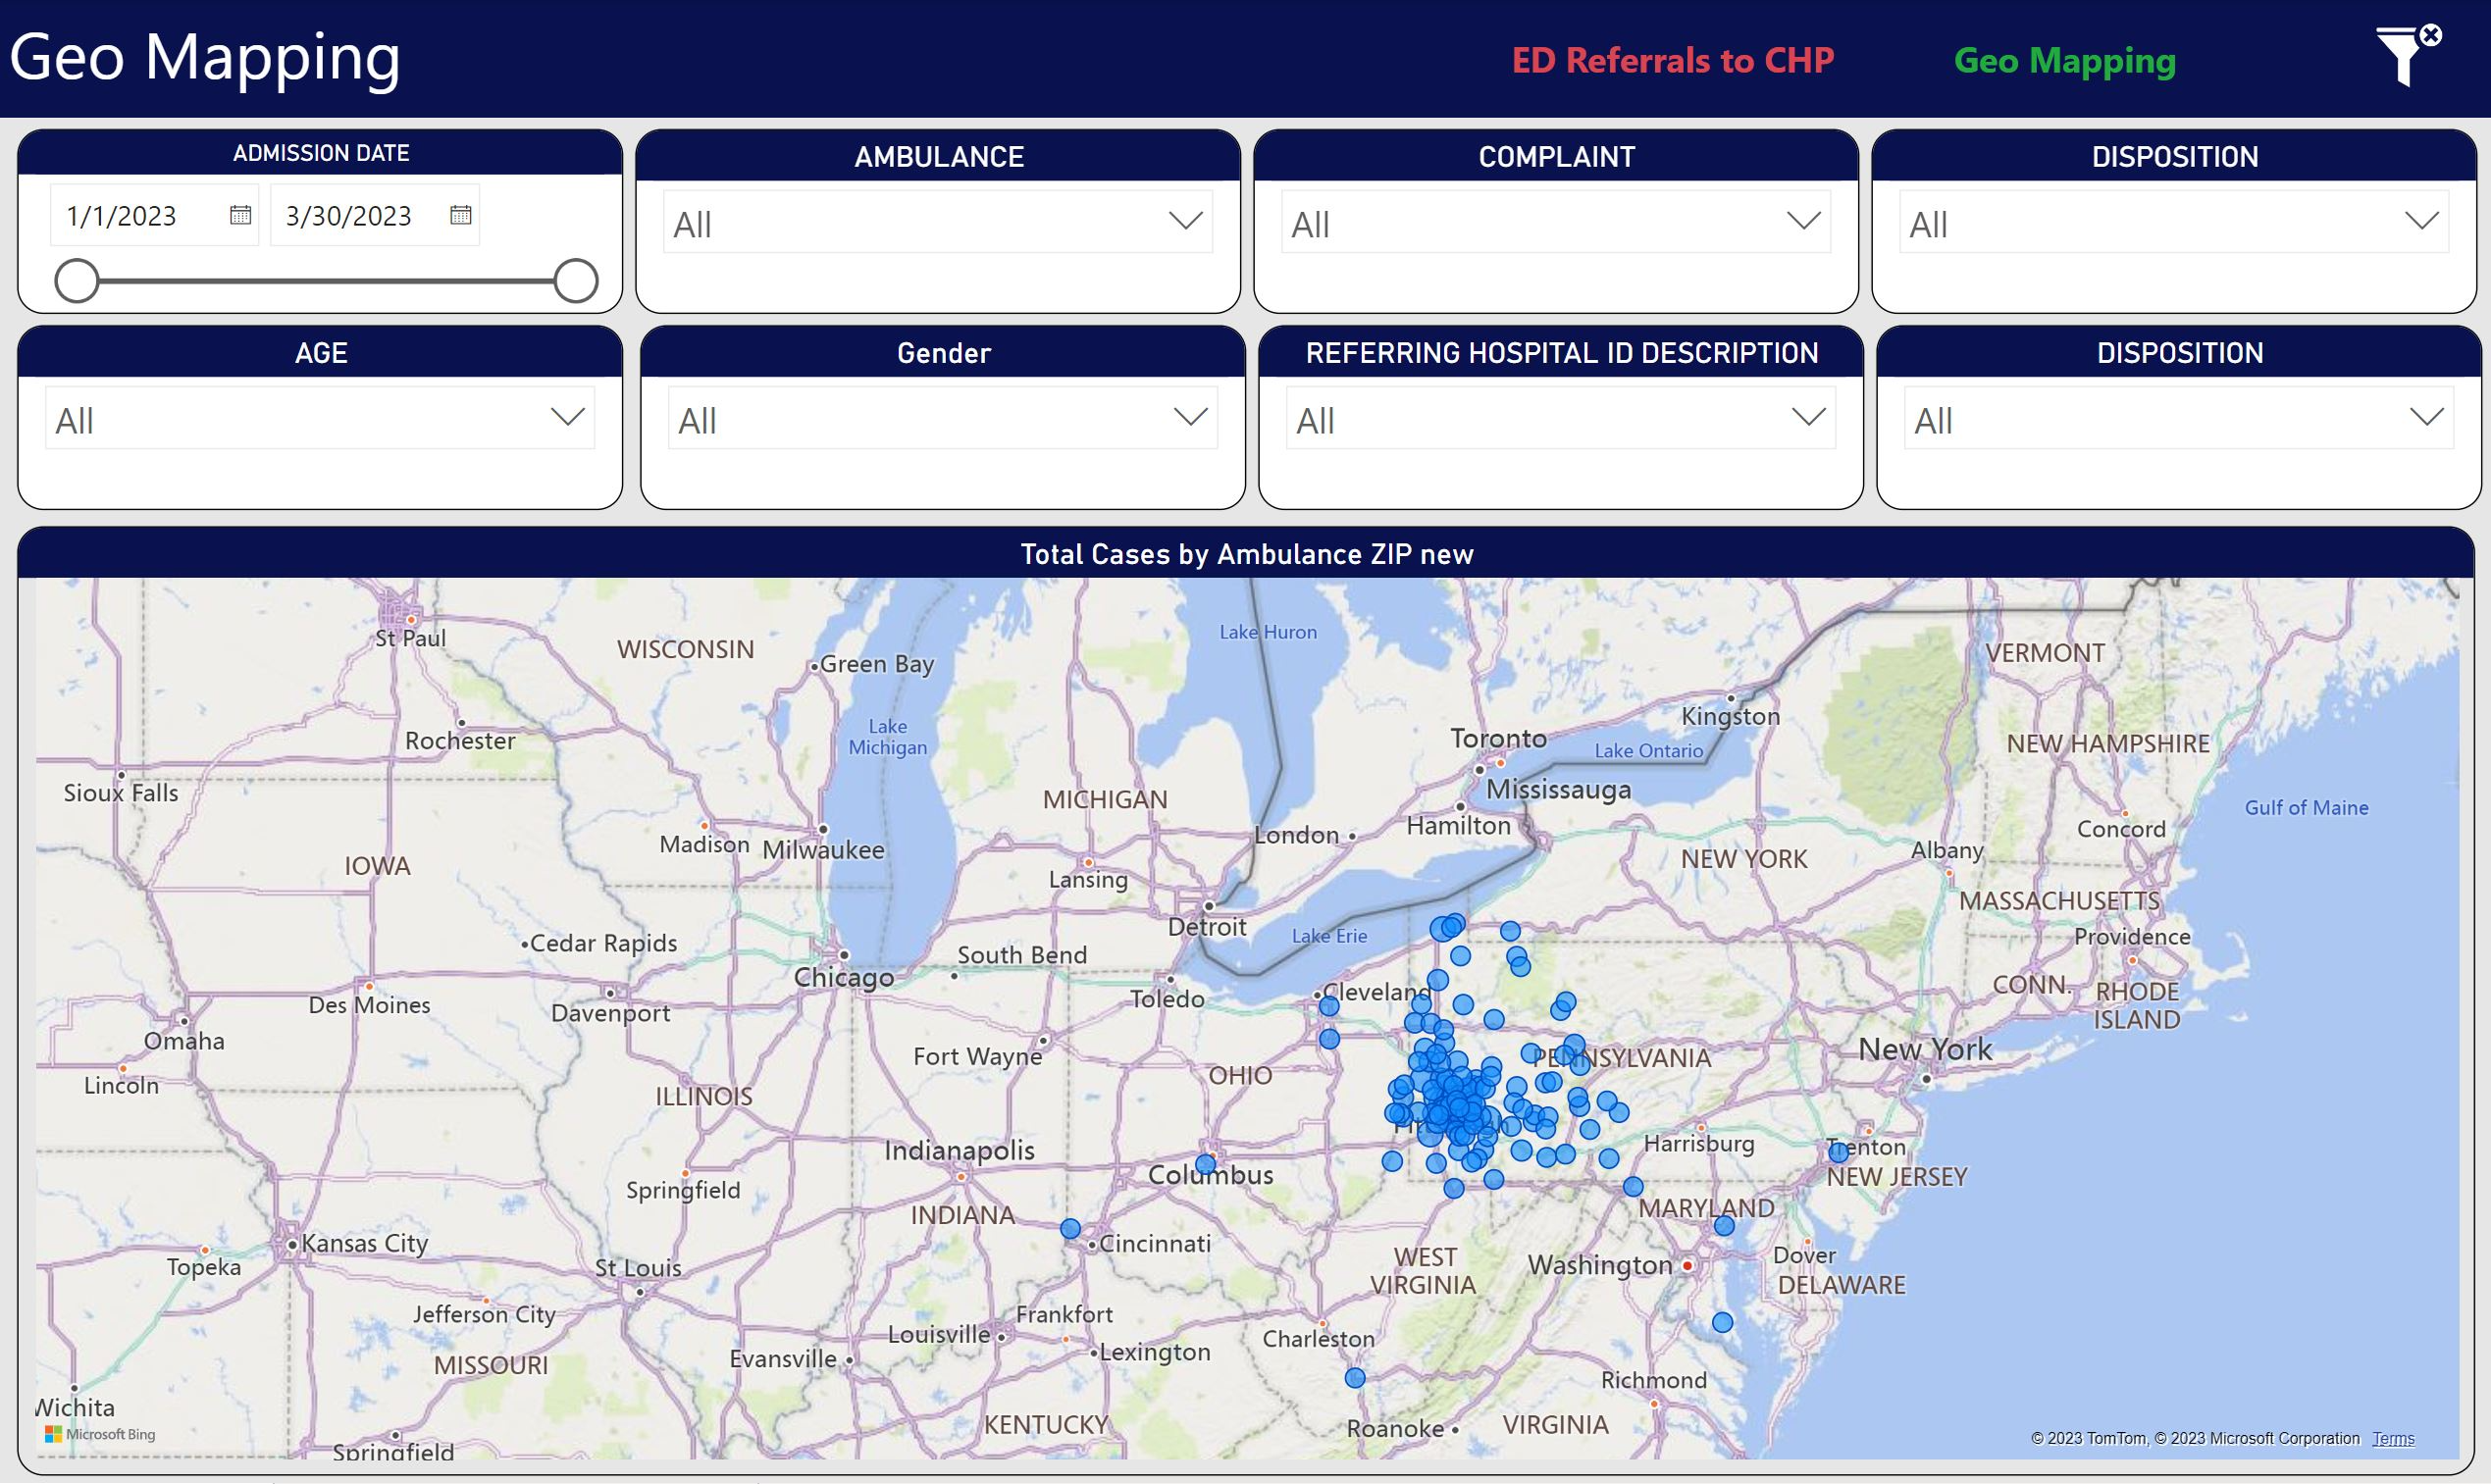
Results
Notes:
In summary, the data provides insights into the referral process of the Pittsburgh Children's hospital. It is evident from the analysis of the data that the referrals occur more frequently for patients aged between one and three years. Additionally, the majority of the referrals are from emergency with 1,872 cases and there was a total of 2,661 cases. When ED admission dates are broken down by month, March had the most cases (920), and when they are broken down by day of the week, Tuesday had the most cases (423). Most cases were admitted to the ED around 8 o'clock, according to a breakdown of admission dates by hour. Furthermore, the data presents the most common reasons for complaints to the hospital, with the top three being general med, seizure, and fever. The findings also indicate that patients referred to this hospital are spread across multiple different ambulances, with no single ambulance accounting for the majority of the referrals.
All in all, the data plays a critical role in revealing important patterns within the referral process in a medical setting. By leveraging Power BI as a tool for analysis, it is possible to uncover these patterns and create insights to guide healthcare practitioners and administrators in their decision-making.

Slide 10


Recommendations
Notes:
Based on my analysis, I recommend that Children's Hospital of Pittsburgh continue to utilize the Power BI tool and develop additional dashboards that can provide data-driven insights into patient referrals. I believe that such technology can greatly enhance the hospital's ability to manage patient care, reduce costs, and improve outcomes. Additionally, I would recommend that the hospital invest in training programs to help staff and providers better understand how to use and interpret the data provided. Lastly, the hospital should continuously monitor the reasons for the visit and complaints, to identify patterns and develop interventions to improve the quality of care provided to patients.
Most importantly, healthcare organizations should ensure that the data they use in Power BI is HIPAA compliant. Specifically, healthcare organizations should encrypt data and limit access to authorized personnel only. Moreover, healthcare organizations should ensure that any data shared outside the organization is de-identified to protect patients' privacy.

Slide 11

Notes:
The dashboard I developed using Power BI for Children's Hospital of Pittsburgh allowed me to gather valuable insights into patient referral trends while maintaining compliance with HIPAA and PHI laws. This information could help medical professionals create targeted staffing plans and develop more effective response plans for patients in critical situations. Additionally, the geographical distribution of ambulance zip codes and referral volumes allowed us to identify areas requiring additional attention. I believe that this project provides a solid foundation for continued investigation into healthcare analytics and can be a valuable tool for healthcare organizations looking to enhance their understanding of patient referral trends.
Through the project, I was able to acquaint myself with various tools, functionalities, and technologies available within Power BI, which helped me to mine, transform, and visualize the data. As a result, I was able to design an intuitive and interactive dashboard that not only provided critical insights into the hospital's 3-month referral data but also demonstrated the potential of Power BI in facilitating decision-making processes. The project outcome has highlighted the importance of leveraging data analytics resources for transforming complex data into actionable insights that can aid in enhancing hospital performance.

